Slide 1
Familiarize yourself with phishing attacks -HRM and Marketing Teams - Identified as the most at-risk By: Mastercard IT and Cybersecurity Team
Notes:
Hello HRM and Marketing Teams!
This is the Mastercard IT and Cybersecurity Team.
We are presenting this so that you can familiarize yourself with phishing attacks as we have found based on our data that you are mostly at risk of these attacks.
There was a 75 percent chance of phishing infection by the HRM and about 25 percent for the marketing team.
This presentation should help you with the basics of phishing.

Slide 2
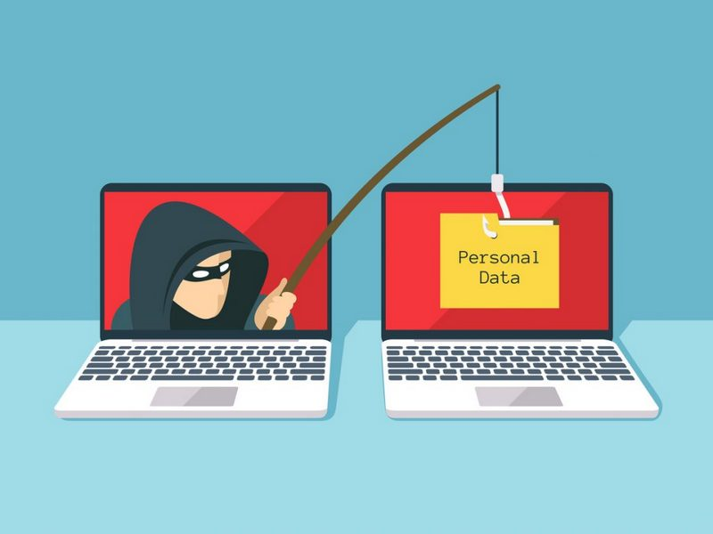
What is phishing?
Phishing is a scam or trick by which a victim is convinced to reveal personal or confidential information.
This allows the perpetrator to steal and sell the data from a victim.
usernames, passwords, credit card numbers, bank account information
It is usually in the form of email, text messaging, or telephone.
Ex: A fishing bait catches the fish. A phishing scam/trick gets information about the victim.
Ex: Sends email to reset password. You reset the password. Then, the perpetrators have your username, password, and account.
This Photo by Unknown Author is licensed under CC BY-SA
Notes:
Phishing is a scam or trick by which a victim is convinced to reveal personal or confidential information.
This allows the perpetrator to steal and sell the data from a victim.
usernames, passwords, credit card numbers, bank account information
It is usually in the form of email, text messaging, or telephone.
Ex: A fishing bait catches the fish. A phishing scam/trick gets information about the victim.
Ex: Sends email to reset password. You reset the password. Then, the perpetrators have your username, password, and account.

Slide 3
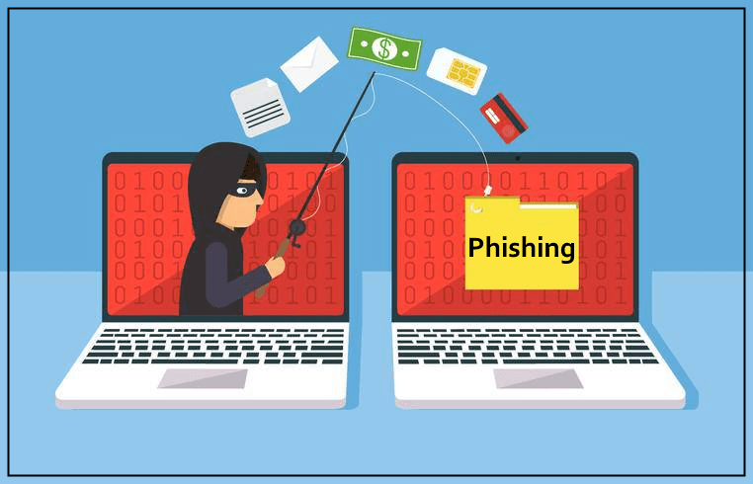
Four types of Common Phishing
This Photo by Unknown Author is licensed under CC BY-NC-ND
Spear Phishing:
To trick a targeted person into revealing personal information while having some relevant information about the target.
Whaling:
Like a sub-type of Spear Phishing and is targeted to business executives, celebrities, and high-net-worth individuals on personal information and assets.
Smishing:
The phishing message is sent by text message (SMS/iMessage) with the notification that the victim has received it and read the message to lure the victim to reveal personal information.
Vishing:
The phishing message is sent by phone call where the attackers call the victim with a pre-recorded message or a script to lure the victim to reveal personal information.
Notes:
Spear Phishing:
To trick a targeted person into revealing personal information while having some relevant information about the target.
Whaling:
Like a sub-type of Spear Phishing and is targeted to business executives, celebrities, and high-net-worth individuals on personal information and assets.
Smishing:
The phishing message is sent by text message (SMS/iMessage) with the notification that the victim has received it and read the message to lure the victim to reveal personal information.
Vishing:
The phishing message is sent by phone call where the attackers call the victim with a pre-recorded message or a script to lure the victim to reveal personal information.

Slide 4
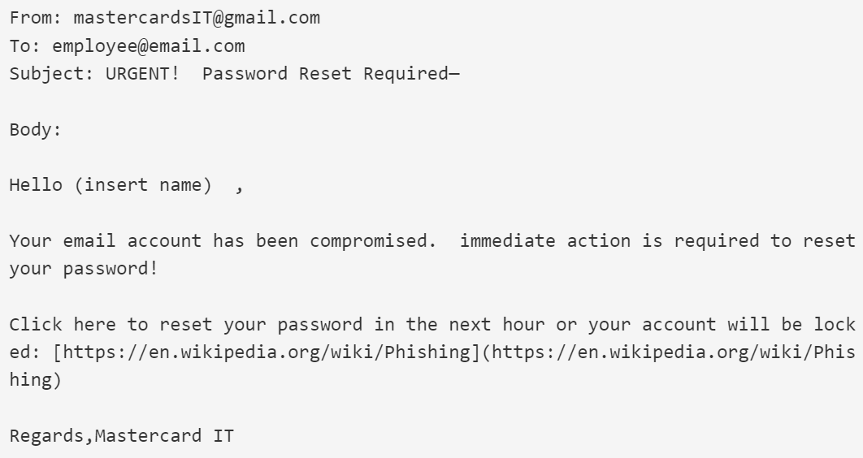
Learn to spot phishing emails
Urgent call to action or threats
First-time, infrequent senders or senders marked [External]
Spelling and bad grammar
Generic greetings
Mismatched email domains
Suspicious links or unexpected
Notes:
These are the most reasons to detect phishing emails and how they are not a great example of good emails.
The Photo to the right depicts the phishing or fake email.
Spot it as:
Urgent call to action or threats
First-time, infrequent senders or senders marked [External]
Spelling and bad grammar
Generic greetings
Mismatched email domains
Suspicious links or unexpected

Slide 5
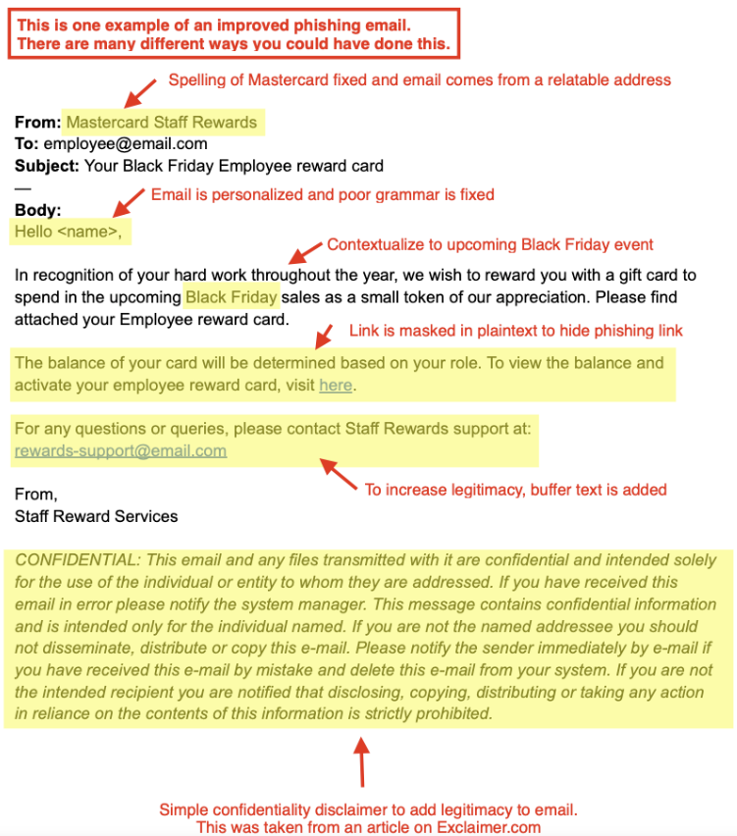
How do we stop getting phished?
Be suspicious of emails and Teams messages that claim you must click, call, win a prize, or open an attachment.
Do not open emails from somebody you don't recognize, or the email identifies as a new sender
If an email has obvious spelling or grammatical errors, it may be a scam. Most professional emails are grammar-free.
If an organization, you work with knows you it should not state in the introductions that it is a “sir” or “madam” as it implies that it does not know you.
If the organization is sending the email from a different domain do not open or click the links as it is a scam. Also, any bad grammar on domains as well.
Any suspicious links or attachments should not be clicked or opened. You can hover over it but do not click on them.
Improve sending professional emails to avoid false positives (Right Photo Example)
Notes:
Be suspicious of emails and Teams messages that claim you must click, call, win a prize, or open an attachment.
Do not open emails from somebody you don't recognize, or the email identifies as a new sender
If an email has obvious spelling or grammatical errors, it may be a scam. Most professional emails are grammar-free.
If an organization, you work with knows you it should not state in the introductions that it is a “sir” or “madam” as it implies that it does not know you.
If the organization is sending the email from a different domain do not open or click the links as it is a scam. Also, any bad grammar on domains as well.
Any suspicious links or attachments should not be clicked or opened. You can hover over it but do not click on them.
Improve sending professional emails to avoid false positives (Right Photo Example)
Thank you for coming to the presentation by the Mastercard IT and Cybersecurity team.

